Slide 1
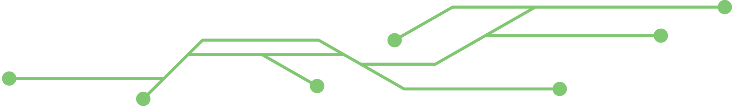


Faster Attention
Is All You Need
Presented by: Joey Cherisea, Chenchen Feng, Nuanxin Jin, Yingcong Lu
Notes:
Introduced in 2017 in a groundbreaking paper titled “Attention is all you need”, attention mechanism didn’t attract much public attention ☺ until the release of Chat-GPT 5 years later in 2022.
As transformer-based large language models find application in a wide variety of scenarios, it becomes increasingly obvious the very innovation that thrusts it to stardom is also a major bottleneck that limits its capability.

Slide 2
Standard Attention
Input
Thinking
Machines
W^{Q}
Embedding
E₁
2.9 | 1.0 | 0.2 | 1.7
E₂
7.8 | 6.6 | 2.4 | 2.1
Queries
q₁
q₂
W^{K}
Keys
k₁
k₂
Values
v₁
v₂
W^{V}
Notes:
To understand the problem we want to research on, we need to understand what an attention mechanism is.
For the sake of illustration, let’s use a simple string “Thinking machines” as an example. This input is first mapped to a word embedding, which is basically a fancy word for multi-dimensional vector.
Our embedding is then projected down into three derived vectors by multiplying it with a learnt weight matrix.
The first one is a weight matrix for query, which generates two corresponding query vectors. Similarly, multiplying the embedding vector with a key matrix results in two key vectors. And a third one would generate two value vectors.

Slide 3
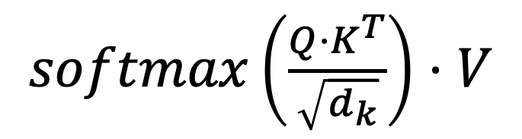
Attention Matrix
 | E₁ -> Q₁ | E₂ -> Q₂ | E₃ -> Q₃ | E₄ -> Q₄ | E₅ -> Q₅ | E₆ -> Q₆ | E₇ -> Q₇
E₁ -> K₁ | K₁ Q₁ | K₁ Q₂ | K₁ Q₃ | K₁ Q₄ | K₁ Q₅ | K₁ Q₆ | K₁ Q₇
E₂ -> K₂ | K₂ Q₁ | K₂ Q₂ | K₂ Q₃ | K₂ Q₄ | K₂ Q₅ | K₂ Q₆ | K₂ Q₇
E₃ -> K₃ | K₃ Q₁ | K₃ Q₂ | K₃ Q₃ | K₃ Q₄ | K₃ Q₅ | K₃ Q₆ | K₃ Q₇
E₄ -> K₄ | K₄ Q₁ | K₄ Q₂ | K₄ Q₃ | K₄ Q₄ | K₄ Q₅ | K₄ Q₆ | K₄ Q₇
E₅ -> K₅ | K₅ Q₁ | K₅ Q₂ | K₅ Q₃ | K₅ Q₄ | K₅ Q₅ | K₅ Q₆ | K₅ Q₇
E₆ -> K₆ | K₆ Q₁ | K₆ Q₂ | K₆ Q₃ | K₆ Q₄ | K₆ Q₅ | K₆ Q₆ | K₆ Q₇
E₇ -> K₇ | K₇ Q₁ | K₇ Q₂ | K₇ Q₃ | K₇ Q₄ | K₇ Q₅ | K₇ Q₆ | K₇ Q₇
O(n²)
Notes:
These vectors then form what’s called an attention matrix, or a context window. It basically defines how many tokens the attention mechanism can handle at once.
Afterwards, we apply softmax to the dot product of query and key vectors along the columns and multiply the result by the value vector.
From this graph, our intuition tells us this operation is at least O(n^2) in terms of time complexity, which is really not scalable.

Slide 4

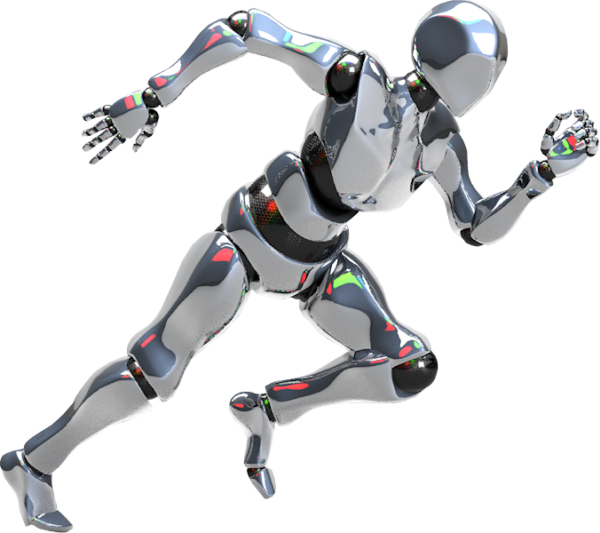

Motivation
Enhance knowledge of Transformer-based LLM
Explore SOTA techniques that enable long context modeling
Notes:
This problem is exactly what motivates us to explore the attention mechanism. Through this project, we aim to strengthen our understanding of transformer-based LLMs.
Furthermore, we want to get a better idea of the current state of art techniques that power long context modeling.

Slide 5
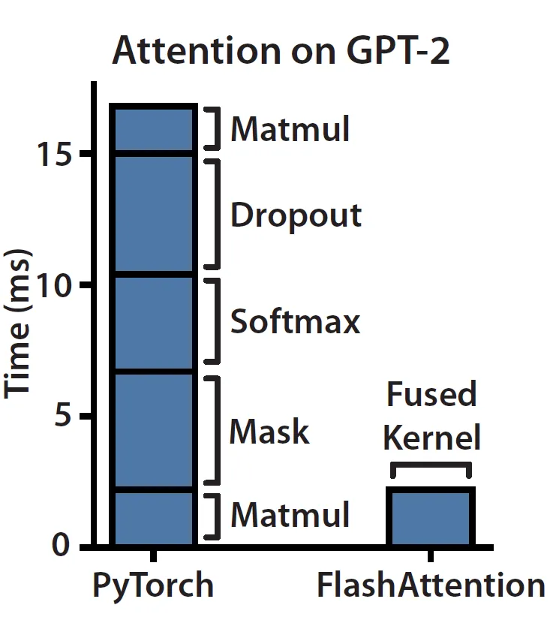
Memory bound operations
Notes:
According to a paper that introduced flash attention, elementwise ops like dropout, softmax and mask in attention takes up the bulk of execution time, even though they are memory bound, not compute bound.

Slide 6
Tiling
 | E₁ -> Q₁ | E₂ -> Q₂ | E₃ -> Q₃ | E₄ -> Q₄ | E₅ -> Q₅ | E₆ -> Q₆ | E₇ -> Q₇
E₁ -> K₁ | K₁ Q₁ | K₁ Q₂ | K₁ Q₃ | K₁ Q₄ | K₁ Q₅ | K₁ Q₆ | K₁ Q₇
E₂ -> K₂ | K₂ Q₁ | K₂ Q₂ | K₂ Q₃ | K₂ Q₄ | K₂ Q₅ | K₂ Q₆ | K₂ Q₇
E₃ -> K₃ | K₃ Q₁ | K₃ Q₂ | K₃ Q₃ | K₃ Q₄ | K₃ Q₅ | K₃ Q₆ | K₃ Q₇
E₄ -> K₄ | K₄ Q₁ | K₄ Q₂ | K₄ Q₃ | K₄ Q₄ | K₄ Q₅ | K₄ Q₆ | K₄ Q₇
E₅ -> K₅ | K₅ Q₁ | K₅ Q₂ | K₅ Q₃ | K₅ Q₄ | K₅ Q₅ | K₅ Q₆ | K₅ Q₇
E₆ -> K₆ | K₆ Q₁ | K₆ Q₂ | K₆ Q₃ | K₆ Q₄ | K₆ Q₅ | K₆ Q₆ | K₆ Q₇
E₇ -> K₇ | K₇ Q₁ | K₇ Q₂ | K₇ Q₃ | K₇ Q₄ | K₇ Q₅ | K₇ Q₆ | K₇ Q₇
Notes:
To solve this problem, researchers came up with an ingenious technique that groups the query-key matrix into tiles. This avoids storing the entire matrix in memory at any given time.

Slide 7
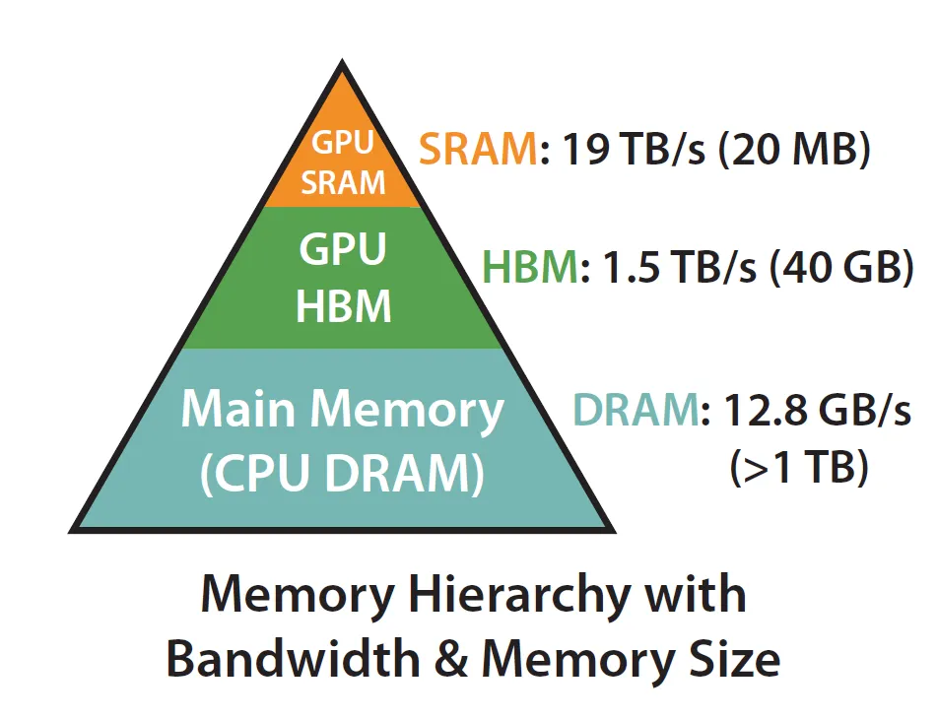
Memory Hierarchy
Q, K and V
Notes:
making it possible to fully utilize the blazingly fast on-chip memory SRAM, which is an order of magnitude faster than HBM, where query, key and value vectors are stored and loaded in standard attention.

Slide 8
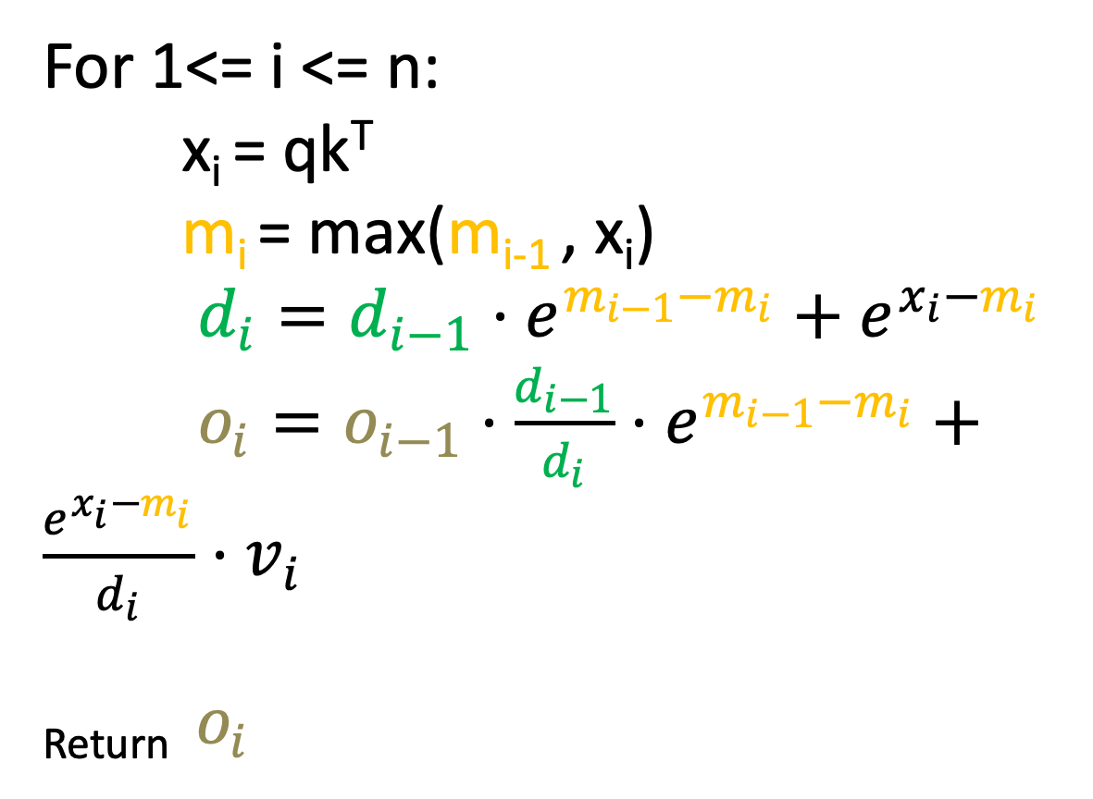
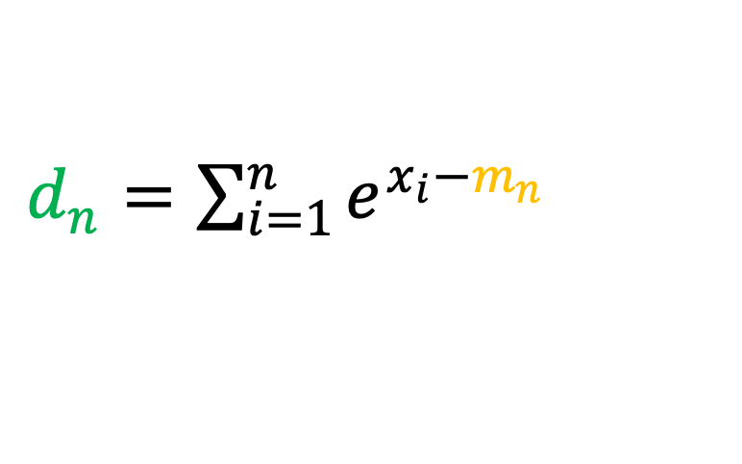
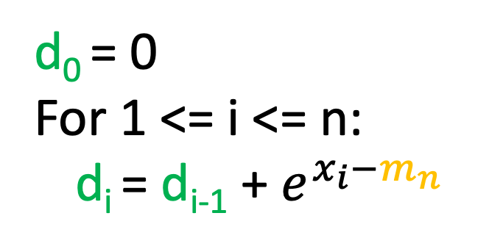
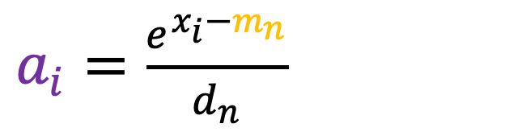
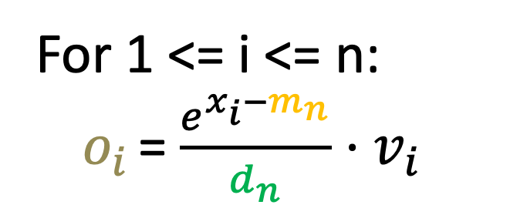
Flash Attention
m_{n} = max(x₀, x₁ … x_{n})
m₀ = -inf
For 1 <= i <= n:
m_{i} = max(m_{i-1} , x_{i})
Fused Kernel
Notes:
Being able to stuff QK vectors into SRAM only solves the first part of the problem. We still need to find a way to compute softmax without knowing the entire matrix. This is where what's called "Fused Kernel” comes in. It basically combines three computation steps into one.

Slide 9
BEFORE
Load Q, K by blocks from HBM
S = QK^{T}
Compute
Write S to HBM
High Bandwidth Memory (HBM)
Load S from HBM
A = Softmax(S)
Write A to HBM
Compute
O = AV
Load A, V by blocks from HBM
Notes:
Here is a direct comparison.

Slide 10
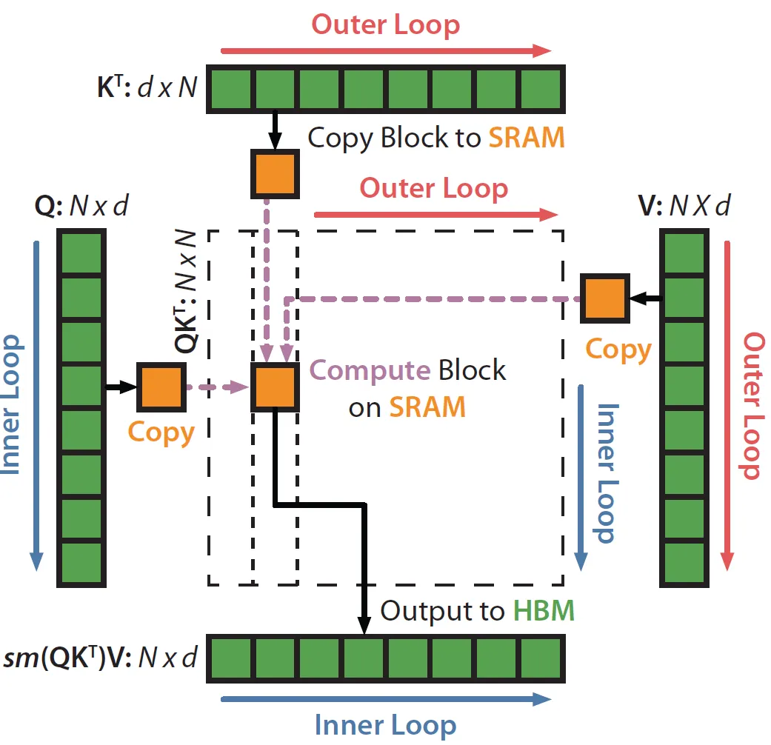
AFTER
Notes:
In flash attention, however.
At each step, we load a tile of query, key and value vectors, compute the result in one operation directly on SRAM and then write it to HBM. This significantly speeds up the attention mechanism.

Slide 11



Dataset
Goal : compare efficiency difference of GPU kernels
Data Choice: synthetic data
Notes:
As for our dataset, we will use synthetic data to demonstrate the advantage of flash attention over standard attention.

Slide 12
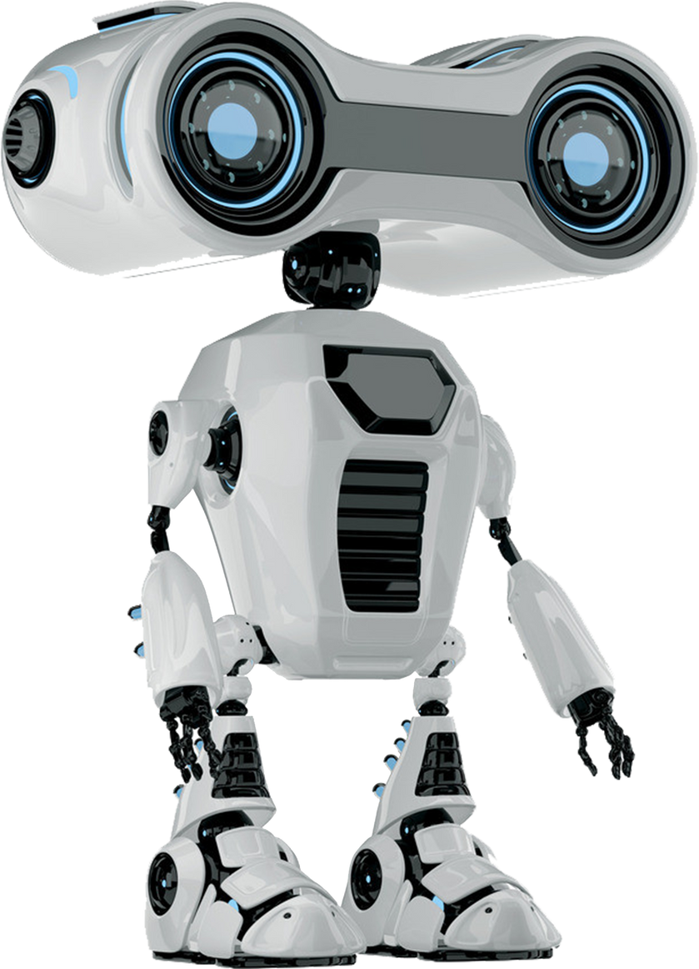

What’s next
Implement GPU kernels in attention and flash attention
Compare their execution time
Draw preliminary conclusions
Notes:
Going forward, we will implement GPU kernels in attention and flash attention to get empirical data on their performance difference.

Slide 13
Thank
You!
Notes:
This concludes our presentation. Thank you for your attention!

